Slide 1
2015 Financial Year Results Presentation

Slide 2
Disclaimer
Important information: forward-looking statements
These materials contain certain forward-looking statements relating to the business of Spire Healthcare Group plc (the “Company”) and its subsidiaries (collectively, the “Group”), including with respect to the progress, timing and completion of the Group’s development, the Group’s ability to treat, attract, and retain patients and customers, its ability to engage consultants and GPs and to operate its business and increase referrals, the integration of prior acquisitions, the Group’s estimates for future performance and its estimates regarding anticipated operating results, future revenue, capital requirements, shareholder structure and financing. In addition, even if the Group’s actual results or development are consistent with the forward-looking statements contained in this presentation, those results or developments may not be indicative of the Group’s results or developments in the future. In some cases, you can identify forward-looking statements by words such as “could,” “should,” “may,” “expects,” “aims,” “targets”, “anticipates,” “believes,” “intends,” “estimates,” or similar words. These forward-looking statements are based largely on the Group’s current expectations as of the date of this presentation and are subject to a number of known and unknown risks and uncertainties and other factors that may cause actual results, performance or achievements to be materially different from any future results, performance or achievement expressed or implied by these forward-looking statements. In particular, the Group’s expectations could be affected by, among other things, uncertainties involved in the integration of acquisitions or new developments, changes in legislation or the regulatory regime governing healthcare in the UK, poor performance by consultants who practice at our facilities, unexpected regulatory actions or suspensions, competition in general, the impact of global economic changes, and the Group’s ability to obtain or maintain accreditation or approval for its facilities or service lines. In light of these risks and uncertainties, there can be no assurance that the forward-looking statements made during this presentation will in fact be realised and no representation or warranty is given as to the completeness or accuracy of the forward-looking statements contained in these materials.
The Group is providing the information in these materials as of this date, and we disclaim any intention or obligation to publicly update or revise any forward-looking statements, whether as a result of new information, future events or otherwise.
2

Slide 3
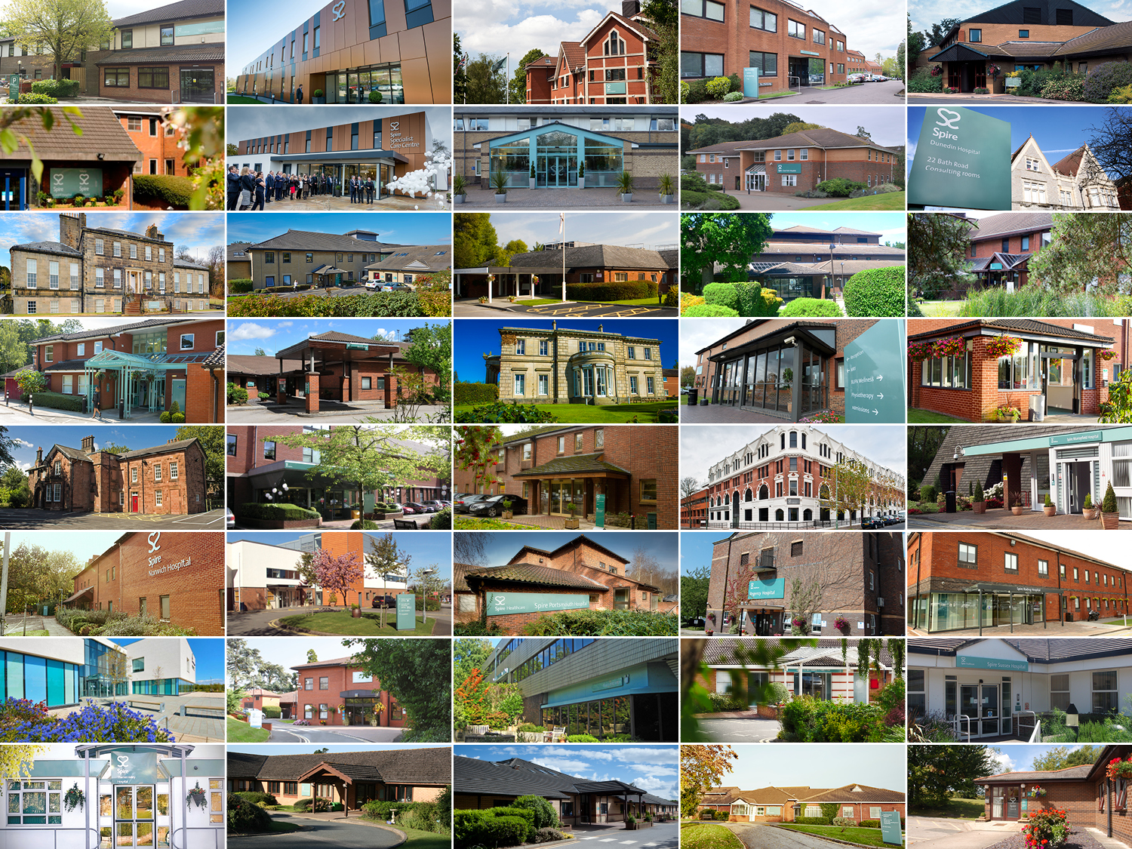
Agenda
1
Introduction
Garry Watts, Chairman
2
Financial Review
Simon Gordon, CFO
3
Strategy Update
Rob Roger, CEO

Slide 4
Introduction
Financial Year 2015 –
highlights
  Successful first full year as a public company with high level of investor engagement and a well spread shareholder base
  New reference shareholder in Mediclinic – the relationship is bearing fruit in shared best practice and experience
  Broad based revenue growth; Spire’s standing has improved post-flotation
  Good financial disciplines, steady margin and strong cash generation
  First full year dividend – 3.7p per share paid / proposed (2014: 1.8p)
  Expansion programme on track, further opportunities identified
  Patient, consultant and staff feedback all improved and very positive
  Spire named as Private Hospital Group of the Year – for the 2nd consecutive year

Slide 5
Introduction
Senior management team
During 2015 Spire significantly strengthened its senior management below Board level
Name | Position
Andrew White | Chief Operating Officer
Peter Corfield | Commercial Director
Jean Jacques de Gorter | Group Medical Director
Neil McCullough | Business Development Director
Caroline Roberts | Human Resources Director
Jonathan Paisley | Chief Information Officer
Dan Toner | General Counsel & Group Company Secretary
Antony Mannion | Investor and Public Relations Director

Slide 6
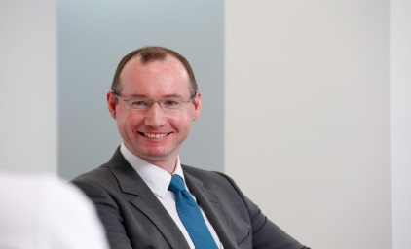
Financial Review
Simon Gordon, CFO
2

Slide 7
Financial Year 2015 - trading headlines
Financial Review
Solid delivery in line with updated guidance
Revenue at £884.8m - in line with updated guidance of between £882m - £888m
    Revenue growth of 3.4% overall with growth across all payor categories
    Revenue growth rates 2015 H1 and H2 impacted significantly by
      Acquisitions and disposals (principally the acquisition of St Anthony’s at the end H1 2014) and NHS local contracts (large swing between H1 & H2 performance following Monitor intervention)
      After account is taken of the above, revenue growth stable in both H1 and H2
EBITDA margin of 18.1% - in line with updated guidance of c.18.0% for the year as a whole
    Margin pressure from clinical staffing cost increases substantially mitigated through cost savings
Adjusted EPS of 18.3p - up 2.2% from 2015
Excellent cash conversion of EBITDA – 104.1% in 2015 (and 104.8% in 2014)
Net debt reduced to 2.6 times EBITDA despite £109m investment in capital expenditure

Slide 8
Financial highlights - Revenues
Financial Review
 | 2015 £m | 2014 £m | Growth %
Group revenue | 884.8 | 856.0 | 3.4%
Acquisitions and disposals | (37.4) | (29.4)
Underlying revenue | 847.4 | 826.6 | 2.5%
2015 revenue mix
2014 revenue mix

Slide 9
Financial highlights - EBITDA
Financial Review
 | 2015 £m | 2014 £m | Growth %
Group EBITDA | 160.1 | 159.2 | 0.6%
PLC costs and rent | - | (2.5)
Adjusted EBITDA | 160.1 | 156.7 | 2.2%
 | 2015 | 2014 | Growth
Adjusted EBITDA margin | 18.1% | 18.3% | (0.2%)

Slide 10
Revenue and admissions growth
Financial Review
Revenues | 2015 £m | 2014 £m | Growth % | Excl. acqn/disp growth %
PMI | 434.8 | 432.4 | 0.6% | (1.1%)
Self pay | 156.2 | 146.1 | 6.9% | 6.6%
NHS | 262.0 | 245.9 | 6.5% | 6.7%
Other | 31.8 | 31.6 | 0.6% | 0.3%
Total revenues | 884.8 | 856.0 | 3.4% | 2.5%
Admissions ’000s | 2015 | 2014 | Growth % | Excl. acqn/disp growth %
PMI | 126.4 | 124.4 | 1.6% | 0.2%
Self pay | 43.4 | 40.4 | 7.4% | 6.8%
NHS | 100.2 | 95.5 | 4.9% | 5.7%
Total admissions | 270.0 | 260.3 | 3.7% | 3.3%

Slide 11
NHS revenues analysis
Financial Review
Revenues | 2015 £m | 2014 £m | Growth %
Choose and book | 202.7 | 181.4 | 11.7%
NHS local | 59.3 | 64.5 | (8.1%)
NHS total revenues | 262.0 | 245.9 | 6.5%
Revenue growth rate | H1 % | H2 % | 2015 Total %
Choose and book | 12.0% | 11.5% | 11.7%
NHS local | 28.9% | (36.4%) | (8.1%)
NHS total revenues | 16.1% | (2.1%) | 6.5%

Slide 12
Revenue bridge by payor
Financial Review
Payor | 2014 £m | Rate £m | Volume £m | OPD £m | 2015 £m
PMI | 416.9 | (0.7) | 0.7 | (4.7) | 412.2
Self pay | 140.1 | 1.0 | 6.2 | 2.1 | 149.4
NHS | 238.8 | (1.2) | 11.2 | 6.1 | 254.9
Totals (Group revenue excl. acquisitions/disposals and other) | 795.8 | (0.9) | 18.1 | 3.5 | 816.5
Day case % admissions | 2014 % | 2015 %
PMI | 73.9% | 75.8%
Self pay | 58.9% | 58.8%
NHS | 73.3% | 74.4%
Totals | 71.3% | 72.5%

Slide 13
Trading margin analysis
Financial Review
Costs as % revenues | 2015 Group % | 2014 Group %
Clinical staff costs | 18.9% | 17.6%
NHS fees | 5.9% | 5.7%
Other direct costs | 27.2% | 27.7%
Cost of sales | 52.0% | 51.0%
NHS fees, % NHS revenues | 19.8% | 19.8%
Costs as % revenues | 2015 Group % | 2014 Group %
Gross margin | 48.0% | 49.0%
Overheads | (22.9%) | (23.6%)
Rent | (7.0%) | (7.1%)
EBITDA adjusted margin | 18.1% | 18.3%

Slide 14
H1 and H2 sub-analysis for 2015
Financial Review
Revenues and EBITDA | 2015 H1 | 2015 H2 | 2015 Full Year
Revenue growth | 7.8% | (0.9%) | 3.4%
Revenue growth excl. acquisitions, disposals and NHS local revenues | 3.3% | 3.5% | 3.4%
Adjusted EBITDA growth | 8.0% | (3.5%) | 2.2%
Adjusted EBITDA margin | 2015 H1 | 2015 H2 | 2015 Full Year
2015 | 18.5% | 17.6% | 18.1%
2014 | 18.5% | 18.1% | 18.3%
Variance | - | (0.5%) | (0.2%)

Slide 15
Comparable EPS performance
Financial Review
 | 2015 £m | 2014 £m | Growth %
Profit before taxation reported | 73.6 | (7.0)
Pro forma adjustments:
Exceptional items | 15.7 | 54.0
Profit on sale of leasehold interest | - | (18.5)
PLC costs and rent | - | (2.5)
Finance costs alignment | - | 65.2
Taxation on adjusted results | (16.3) | (19.6)
Adjusted profit after taxation | 73.0 | 71.6
Pro forma shares in issue (No.m) | 399.9 | 401.1
Comparable Adjusted EPS performance | 18.3p | 17.9p | 2.2%

Slide 16
Cash flow & net debt for the period
Financial Review
 | 2015 £m | 2014 £m
Operating cash flow before exceptional items | 159.8 | 164.2
Exceptional items | (4.5) | (51.2)
Net cash used in investing activities | (109.6) | (70.0)
Net cash used in financing activities | (41.3) | (80.0)
Net increase / (decrease) in cash | 4.4 | (37.0)
Opening cash | 74.5 | 111.5
Closing cash | 78.9 | 74.5
 | £m | Adj. EBITDA leverage
Net debt as at 31 December 2015 | 419.5 | 2.6x
Net debt as at 31 December 2014 | 424.3 | 2.7x
Interest cover (EBITDA /interest paid) | 7.5x

Slide 17
Outlook & guidance for Financial Year 2016
Financial Review
2016 revenue growth between 3-5% converted at EBITDA margin constant to 2015
PMI
  Low single digit revenue growth underpinned by investment in capacity, pricing positive
  PMI market expected to be stable
Self-Pay
  High single digit revenue growth over 2015, pricing positive
  Catalysts for growth – lengthening NHS waiting times and Spire product development
NHS
  Tariff : Q1 - minus 1.8% ; Q2-Q4 - plus 1.5%
  NHS E-referral (formerly “choose and book”) revenue growth low double digit – referral pipeline strong
  NHS local contract revenues down materially in H1, expected to stabilise in H2
  NHS revenue growth overall mid single digit
H1/H2
  Relative revenue and EBITDA growth profile between H1 and H2 will be the reverse of 2015 given NHS local contract revenue challenge persists for H1 2016

Slide 18
Outlook & guidance for Financial Year 2016
Financial Review
2016 revenue growth between 3-5% converted at EBITDA margin constant to 2015
Exception-al items
  Expected £3-5m arising from pre-opening losses in Manchester and Nottingham
  Continuing cost rationalisation initiatives across the business
Capex & dividends
  Capital expenditure of between £170m - £190m, subject to cash flow phasing of developments
  Expected 20% dividend payout ratio on profit after taxation (one-third interim, two-thirds final)
Taxation
  Effective tax rate c.22.0% of profit before taxation of which approximately 50% cash tax
Net debt
  Expected to close 2016 on or around 3.0 times EBITDA leverage

Slide 19
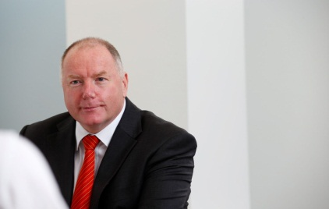
Strategy Update
Rob Roger, CEO
3

Slide 20
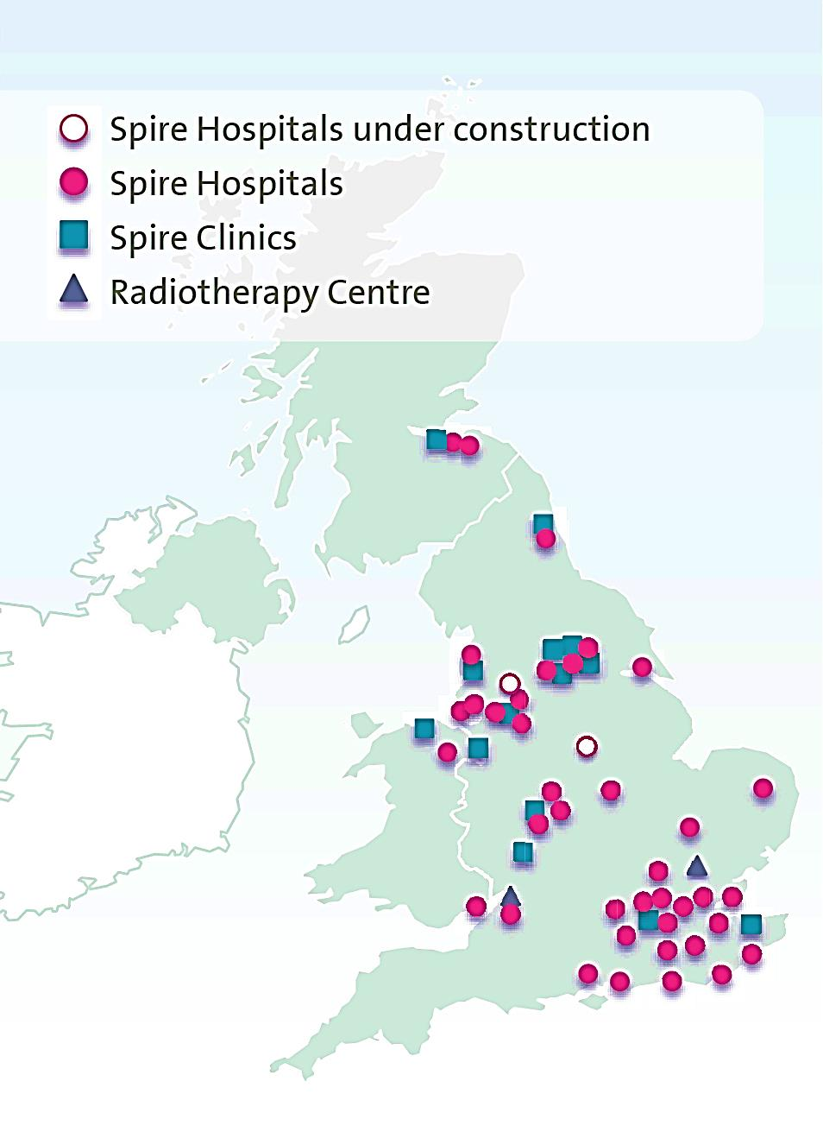

Spire today
Strategy Update
Our assets and services
  Extensive & well invested network
    38 hospitals (full service), with 121 theatres and 2000+ beds
    12 clinics and 2 specialist cancer centres
  Strong culture of clinical governance & excellence
  Diversity of service offering between orthopaedics (49.5%) & other elective (51.5%)
  Growth in high acuity - 6.1% vol. increase in 2015
  Inbuilt “payor hedge” from our three payor groups
  Strong relationships with all key stakeholders

Slide 21
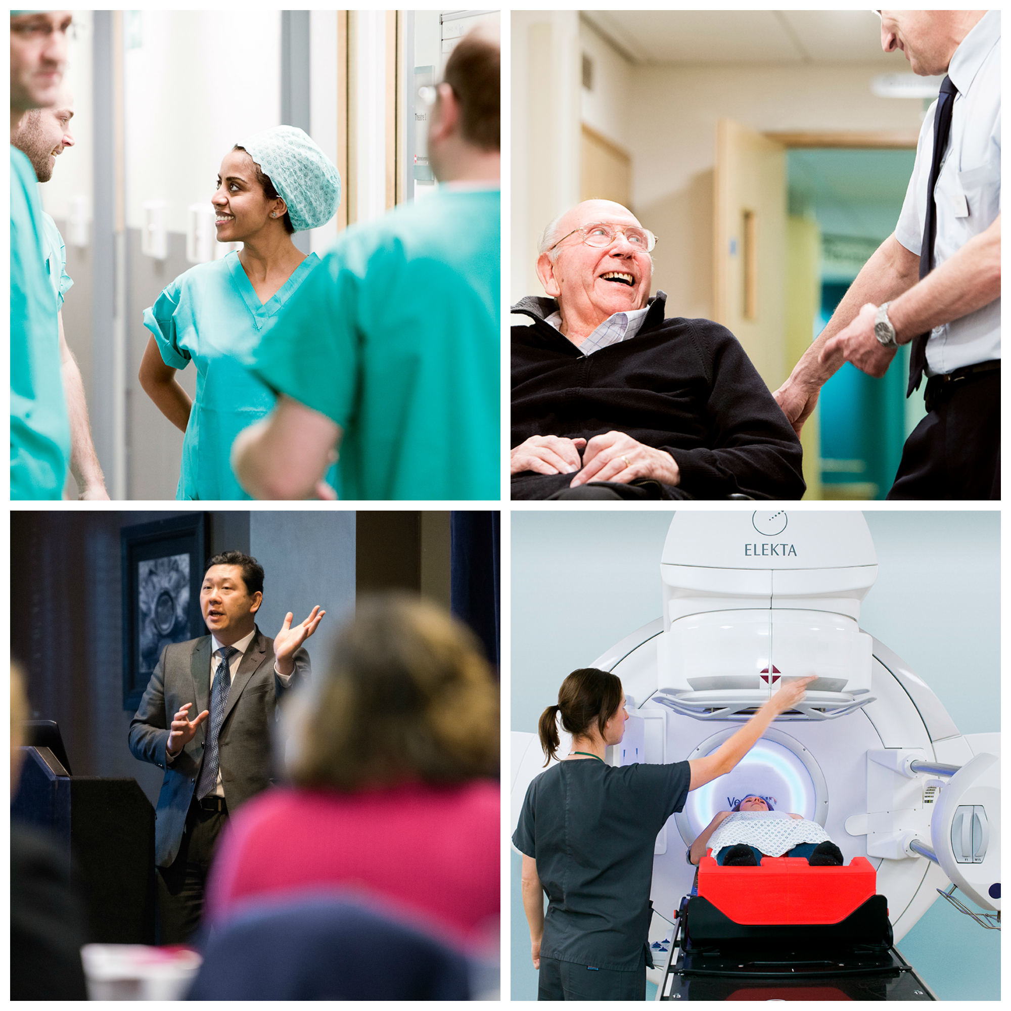
Spire today
Strategy Update
Our people
  Patients: In 2015 we treated 760k patients of which 270k were IP/DC cases (2014: 260k)
    Spire did 7.8% of all UK hip & 8.6% of all UK knee replacement procedures in last 12 months
  Patients: Nearly 2 million IP/DC cases since 2007
  Staff: Over 12,400 colleagues work in our hospitals and clinics
  Consultants: Over 3,750 consultants treat patients in Spire hospitals and clinics
  Record satisfaction scores in 2015: patient (98%), staff (93%) and consultant (79%)

Slide 22
2015 continued our record of Revenue and EBITDAR growth…..
Strategy Update
Revenue (£m)
(2009-15)
EBITDAR (£m)
(2009-15)
+6.1% CAGR
+6.2% CAGR
  Attractive top line growth profile through the downturn, continuing through the post-recession period – with EBIT and EBITDA margins well above industry average

Slide 23
….and also of Revenue growth across all payor groups
Strategy Update
PMI
£m
+2.7%
CAGR
(2009-15)
Self-Pay
£m
+9.9%
CAGR
(2009-15)
NHS
£m
+11.2%
CAGR
(2009-15)

Slide 24
The Spire proposition - more valid than ever
Strategy Update
Demand
  The need for UK healthcare services to be provided by the independent sector will inevitably lead to significant growth in demand
✓
Payors
  Spire has a clear and focused plan to grow its business from each of its three key payor groups, with a natural “payor hedge” in the sector
✓
Capacity
  Spire is on track to deliver significant growth in its capacity, including new operating theatres, new hospitals and new cancer care centres
✓
Productivity
  Spire has the appropriate structure & tools to ensure that sales growth is converted into strong cashflows, for reinvestment into the business
✓

Slide 25
Update on the “NHS Funding Gap”
Strategy Update
The NHS is struggling to find the required £22 billion of cost savings and efficiencies
  Between 2013-14 & 2014-15 NHS productivity actually fell by 1% - while the aggregate NHS deficit for the year to 31st March 2016 is forecast to be £2.8 billion
  The Carter Review confirmed in January 2016 that the maximum cost savings that NHS hospitals can realistically make by 2020-21 is £5 billion
  The King’s Fund estimates NHS spending to fall from 7.3% of GDP in 2014/15 to 6.6% in 2020-21
    Increasing NHS spending to the EU-15 average would require an 8p increase on income tax – but only 38% of people are willing to pay more tax to increase NHS spending
  “There is not yet a convincing plan for closing the £22 billion efficiency gap and avoiding a ‘black hole’ in NHS finances” (Parliamentary Public Accounts Committee, 15 February 2016)
  53% of NHS trust finance directors say that NHS care in their area is deteriorating
  Dissatisfaction of people with the NHS rose from 15 % in 2010 to 23% in 2015, while recent surveys of public attitudes towards the private sector are increasingly positive

Slide 26
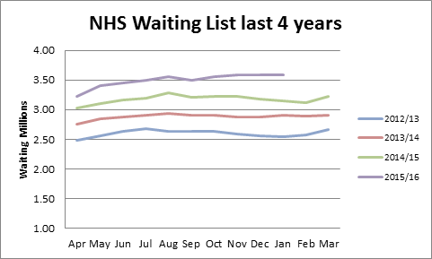
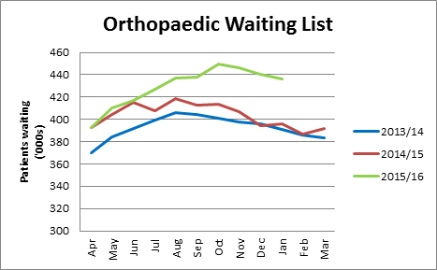
Impact on waiting lists
Strategy Update
  Overall NHS waiting list at Jan 2016 is over 3.5 million – 12% (367k patients) higher than Jan 2015
  In both Dec 2015 and Jan 2016 the 92% target (of treatment within 18 weeks) was missed
    The highest number of patients ever – 263k - waited more than 18 weeks for treatment
  The Orthopaedic waiting list grew from 350k in January 2013 to 436k in January 2016
    Only 89.1% of orthopaedics patients are now treated within 18 weeks (target is 92%)
  Orthopaedics has the longest waiting list of NHS treatments; 56% of our NHS revs are orthopaedic
40% increase in men/20% increase in women under 55 having knee replacement surgery since 2005
75% increase in men/67% increase in women under 55 having hip replacement surgery since 2005

Slide 27
Payors – PMI
Strategy Update
  Despite the UK’s low level of PMI coverage, the attractions of health cover to employers & employees are evident when the NHS is rationing procedures & extending waiting lists
  UK employment numbers have continued to climb to their current record high - a large proportion of new jobs are in sectors likely to buy PMI
  Both employers and employees increasingly see PMI value - 50% of fulltime UK employees place PMI in the top 3 most valued benefits
  The growth of InSpire (10,400 lives in less than 2 years, 86% previously uninsured) shows the opportunity
  87% of GB’s adult PMI & 90% of England’s adult PMI population live within 60 mins drive of a Spire hospital
  To grow the PMI business we are
    working closely with insurers to improve efficiency
    developing “pathway pricing” products for PMI business
    growing InSpire further
  In 2015 Spire hosted 1,110 free GP workshops/seminars /training events
  These were attended by over 18,000 GPs and other healthcare professionals
  Currently only 10-11% of the UK population have PMI cover – low by OECD standards

Slide 28
Strategy Update
Payors – Self-pay
  Because of NHS rationing/waiting lists or a decision to “self-insure”, people are increasingly choosing to pay for their own treatment – which we are seeing in our Self-pay growth rates
  Waiting lists
    25% of over 50s will consider paying for treatment to avoid NHS queues – and this is borne out by our self-pay demographics
  Rationing
    In a December 2015 survey, 73% of GPs said they advise patients they can pay to go private if a procedure is restricted by the NHS
Spire self-pay demographics vs UK population
  To grow the Self-pay business we are
    extending our fixed price coverage for our top 15 procedures to 55 more
    updating our website to improve patient understanding and accessibility
    improving our marketing/sales skills (inc. CRM), & growing MySpire
  2015: NHS Wales waiting lists were over 18 weeks
  2015: Self-pay IP/DC cases at Spire Cardiff grew 14%
  Spire has a simple, transparent message around the affordability of our fixed price proposition
28

Slide 29
Payors – NHS
Strategy Update
  Strong growth in our NHS business will continue in the medium term, with a greater proportion coming from E-referral rather than Local Contract work (82% vs 18% in H2 2015)
  E-referral work ( aka “Choose & Book”) will continue to grow rapidly
    The private sector receives only c.5-6% of E-referral volumes, while only 40% of patients are offered a choice of hospital/clinic by GPs
    E-referral admissions per Spire hospital continue to rise - the Feb 2016 admission number was the highest February ever
  Local Contract work - the recent decline after the Monitor letter of Aug 2015 should flatten out, & recover slightly during 2016 and 2017
  Overall, the private sector is doing more NHS work – NHS’s share of UK hip & knee procedures declined to 65.5% in 2015 (71.3% in 2012)
  To grow the NHS business we are engaging with CCGs to add new services and with Trusts to solve waiting time pressures
79% of people agree “it is fine for the NHS to use private companies to provide services to patients as long as they meet NHS standards, the cost to the NHS is the same or lower, and services remain free at the point of use”

Slide 30
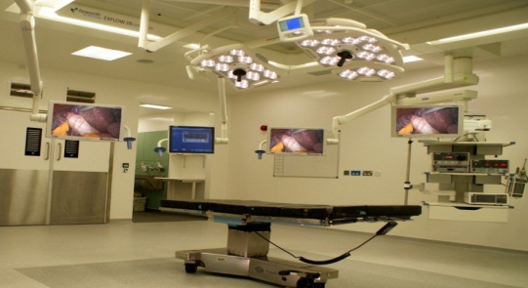
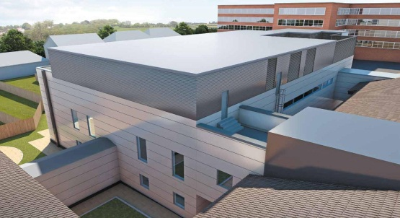
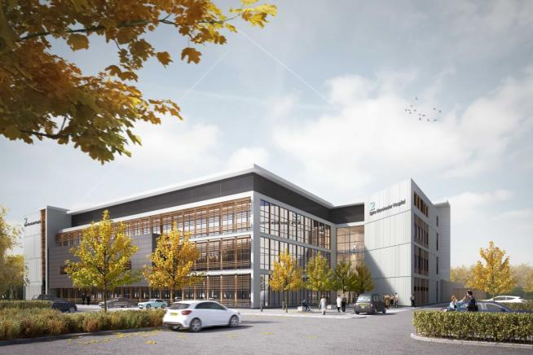
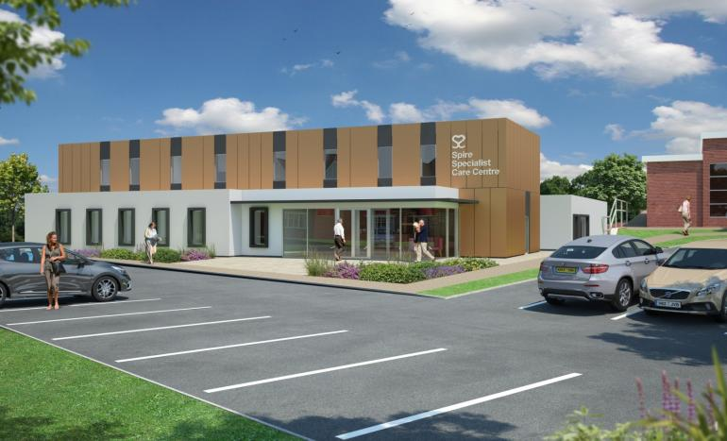
Capacity growth to meet increasing demand and take market share
Strategy Update
Spire’s robust development programme (capital expenditures 2016: £170m to £190m) provides multiple drivers for strong Revenue and EBITDA growth, underpinned by private activity
New theatres
St. Anthony’s
New hospitals
Cancer centres
  Currently 121 operating theatres –will grow to at least 131 theatres by 2018
  Capex per theatre: £3-5m - break even in year 1 on 20% utilisation
  Typical 3-year pre-tax ROCE of 20-25%
  Now fully integrated
  New 6 theatre block (opening Summer 2016) with 84 ward beds, an 8 bed ITU & 19 consulting rooms
  Target 25-30% pre-tax ROCE by 2018 on track: 21% margin in Q4 2015
  Manchester: 6 OTs, 71 beds, clinical trials unit, ITU – open Q1 2017
  Nottingham: 4 OTs, 54 beds, ITU - open Q1 2017
  Further sites including Central London - ongoing
  Target year 5 pre-tax ROCE of 20-25% per site
  Two sites open, at Bristol and Baddow – 3 sites under discussion
  2 bunkers per site at capex of £12-13m –break even in year 1 on PMI/Self-pay activity
  Target year 5 pre-tax ROCE: 20%

Slide 31
Despite an unpredictable 2015, Spire’s future is bright
Summary
  FY2016 will be a year of continued solid growth with Spire expected to return to historical levels of sales growth in H2 2016
  The high H1 2015 NHS comparator will impact H1 results but work itself out by H2
  The resilience of Spire’s business model is clear - in 2015 when Sales grew by 3.4%, our EBITDA margin remained above 18%
  We convert EBITDA to Operating Cash Flow at a high rate (2011-2015 average = c.98%)
  The NHS continues to struggle, with no appetite from Government or taxpayers to significantly increase funding
Spire is uniquely positioned to capture a growing share of a rapidly expanding UK private healthcare market
Fast growing market arising from persistent and growing demand & supply gap
Well-positioned through a network of well-invested and scalable hospitals
Culture of excellence valued by consultants, GPs, patients and payors
Strong cash flows and balance sheet to finance multiple growth opportunities
New strategic shareholder supports both the business and our growth ambitions

Slide 32



2015 Financial Year Results Presentation

